Slide 1
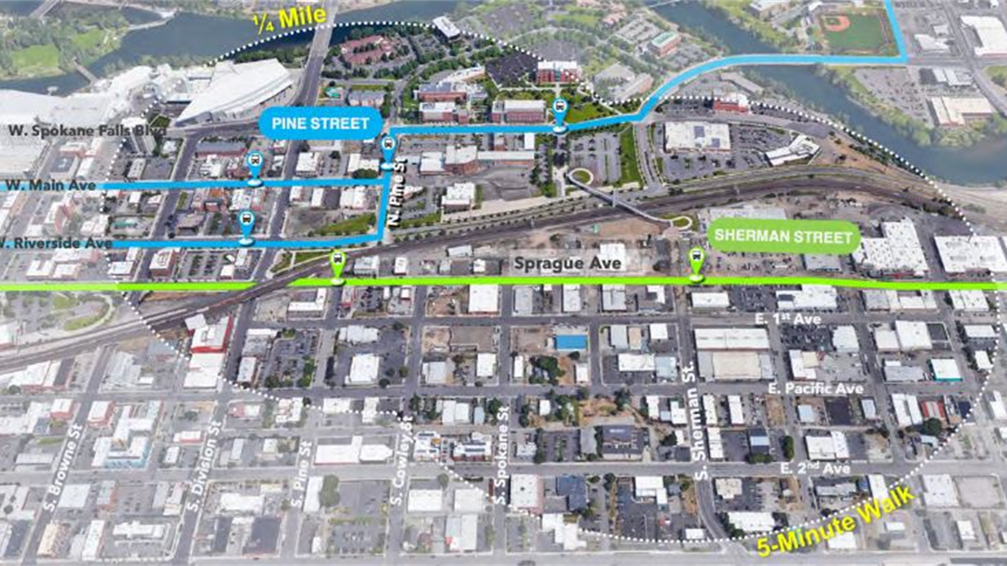
TOD Study Prioritization Discussion

Slide 2
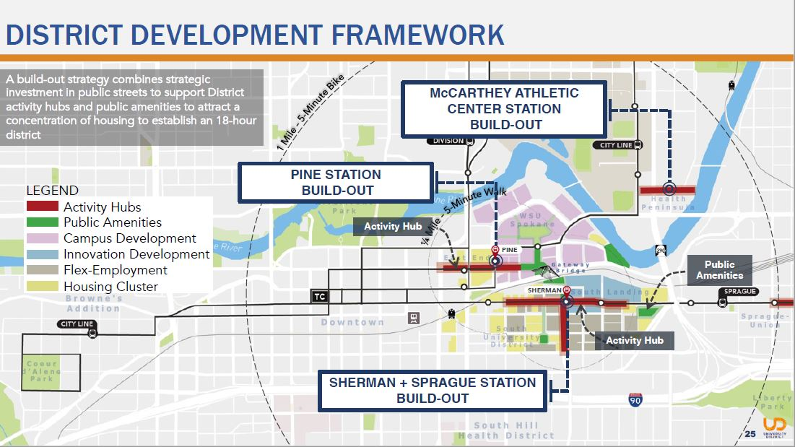
Transit- Oriented Development Study
Development Committee to prioritize Center-Based Planning recommendations.
Task Force to look to bigger vision around how Energy, Infrastructure, and Mobility strategies can support and expand on TOD vision.

Slide 3
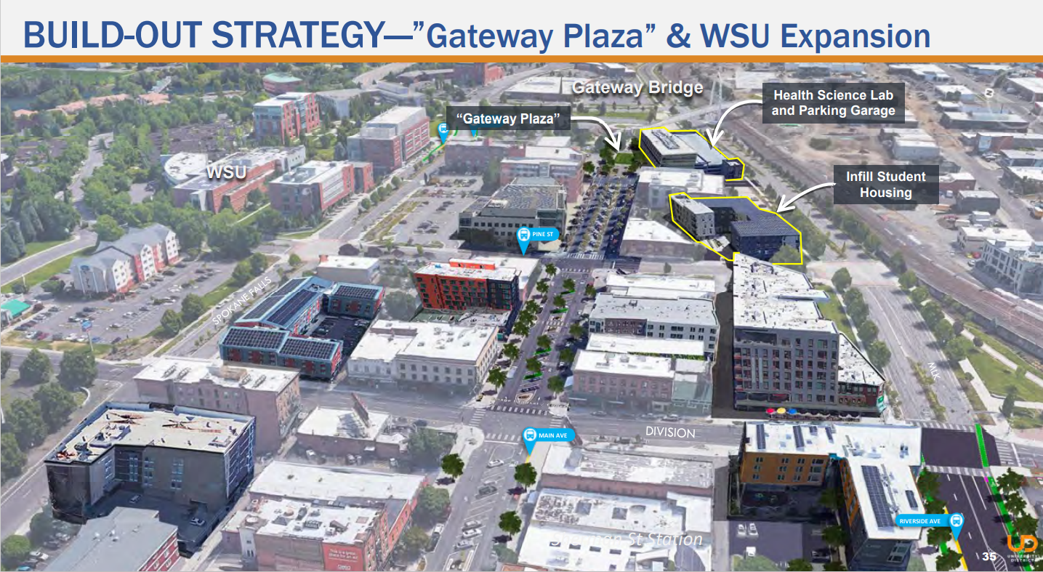
Pine Street Build-Out Strategy
Key Components
  Extension of Main Avenue/Center Parking and/or Greenway
  Gateway Plaza at eastern terminus of Main Avenue
  Further links to “Front Avenue” Park
  Infill Student Housing and Parking Garage along MLK Jr. Way
  Main Avenue supports retail, dining, entertainment (18-hour activity)
  Support connections to walk/bike network (Protected Bikeways and Spokane Culture Corridor)

Slide 4
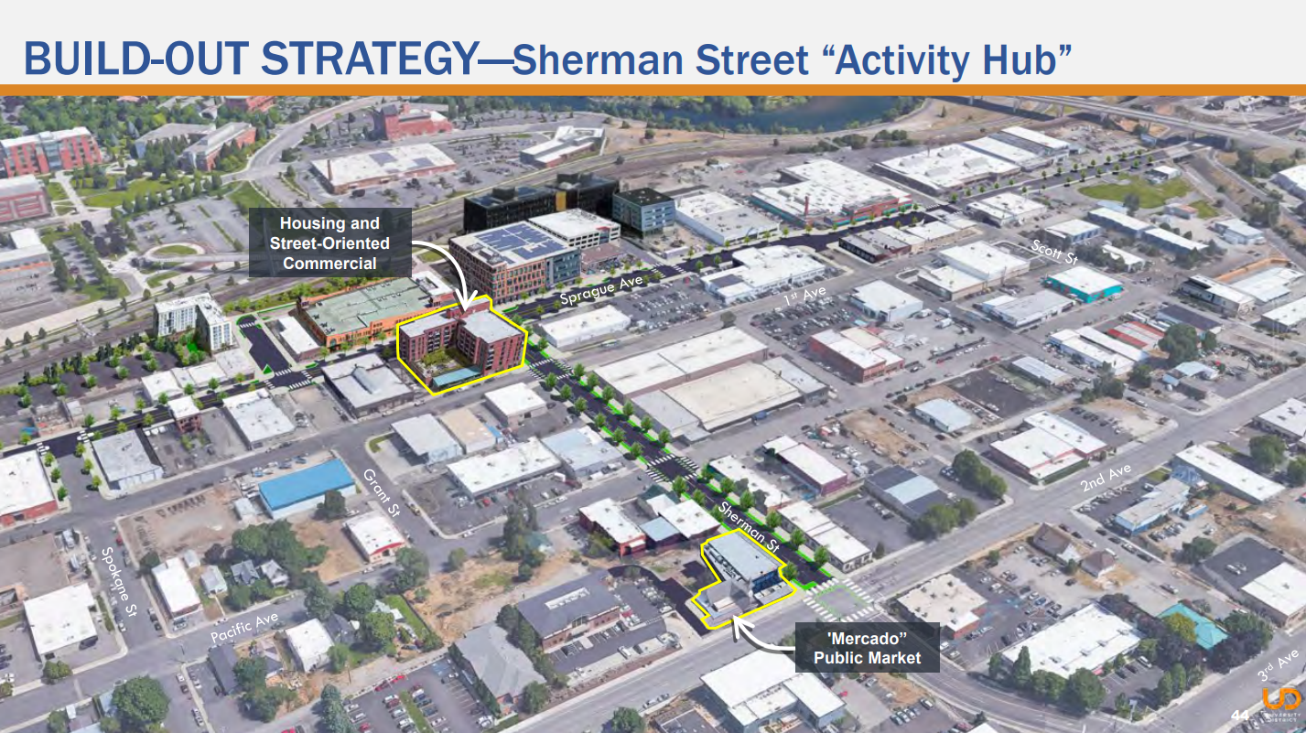
Sherman Street
Build-Out Strategy
Key Components
  Create three primary Activity Hubs: Sherman Hub, East End Hub, West End Hub
  Public Amenities: Gateway Park, Sherman Plaza, “Boxyard” Park, and South Landing Park
  Sprague Ave and Sherman Street support retail, dining, entertainment (18-hour activity)
  Housing Cluster (west and east end)
  Walk/bike network: Grant Ave, Pacific Ave Greenway, 2nd and 3rd Streets
  Grant Ave Promenade: Bookend of ‘Mercado’ public market and Gateway Park

Slide 5
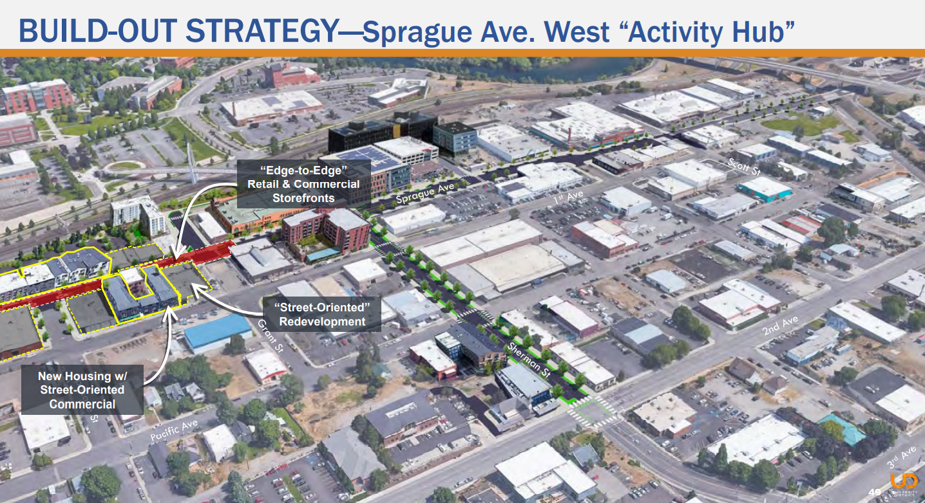
Sprague Avenue WEST and EAST Activity Hub
Key Components
  Edge to Edge Retail and Commercial Storefronts
  Street-Oriented Redevelopment
  New Housing with Street-Oriented Commercial
  Main Ave supports retail, dining, entertainment (18-hour activity)

Slide 6
